Slide 1
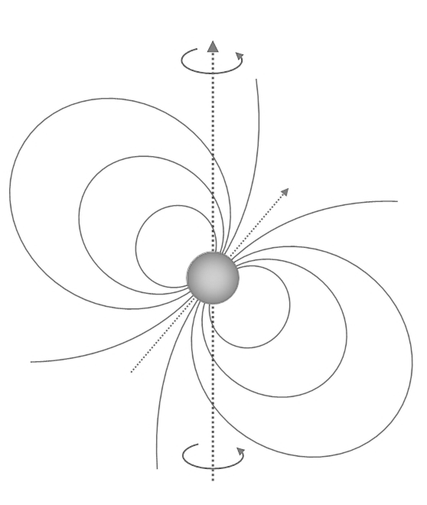
PSR J1023+0038
Adam Mendoza

Slide 2
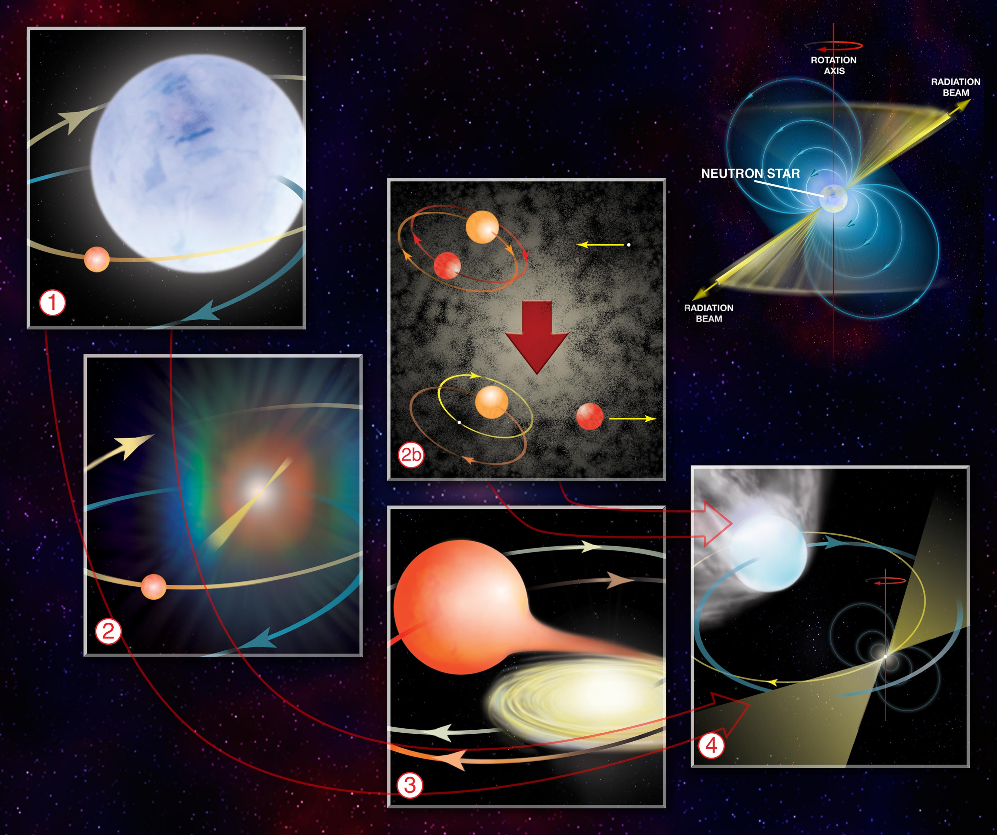
Standard Formation Scenario
Binary system where a star undergoes a supernova.
Companion star swells at some point, allowing the remnant neutron star to accrete material from it for a long period of time (low mass X-ray binary or LMXB).
Accretion increases neutron star rotation, allowing it to become a MSP at a long enough timescale.

Slide 3
PSR J1023+0038 is weird
J1023 was first detected with clear signs of an accretion disc. It was later on identified as a neutron star in a LMXB.
Observations in 2003-2005 revealed no presence of an accretion disc and was later classified as a radio MSP.
Since 2013, it settled in a LMXB state.
PSR J1023+0038 was classified as a transitional millisecond pulsar (tMSP)

Slide 4
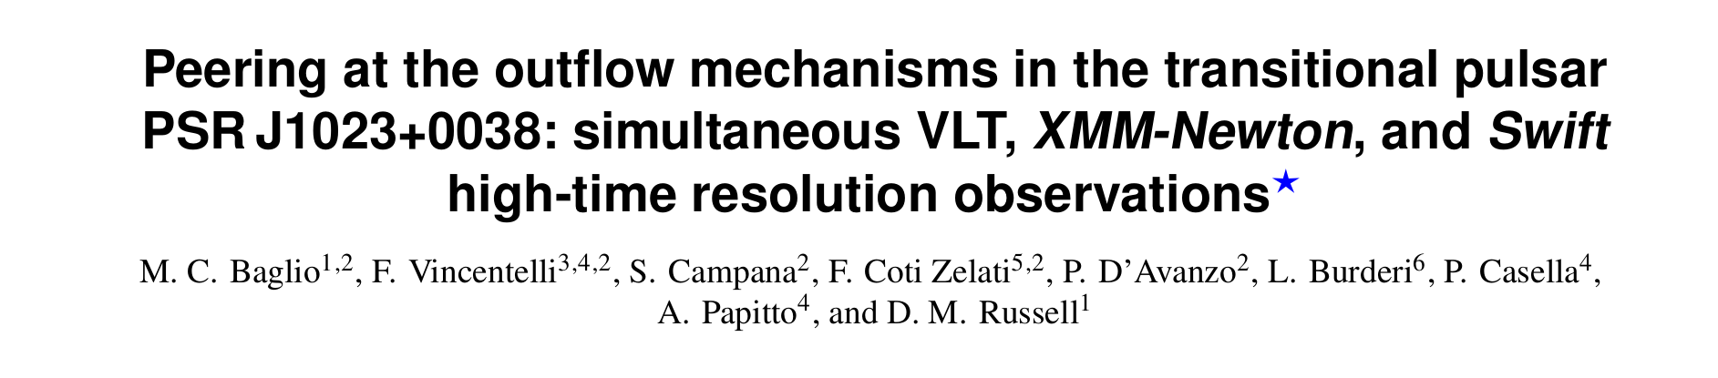
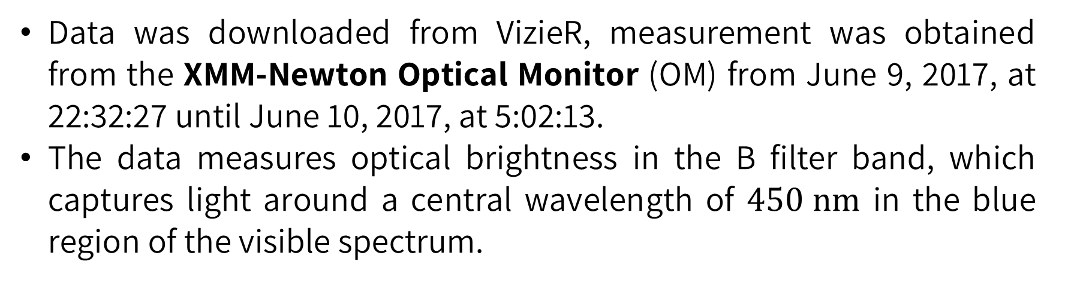
Dataset description
Data was downloaded from VizieR, measurement was obtained from the XMM-Newton Optical Monitor (OM) from June 9, 2017, at 22:32:27 until June 10, 2017, at 5:02:13.
The data measures optical brightness in the B filter band, which captures light around a central wavelength of $450 nm$ in the blue region of the visible spectrum.

Slide 5
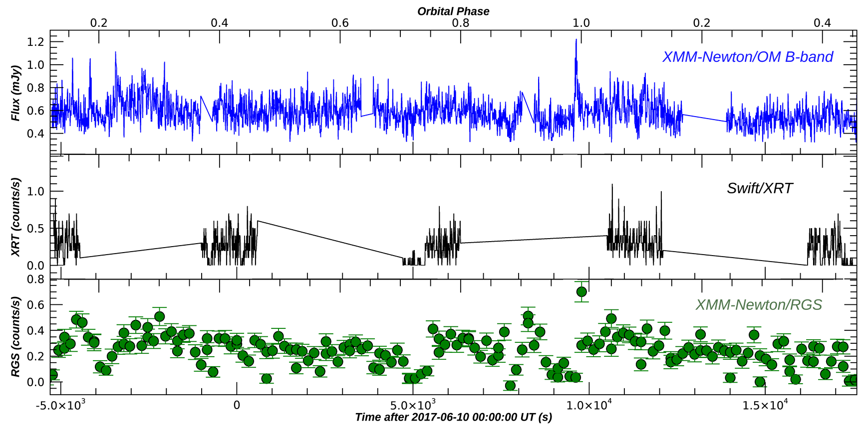
Light curves

Slide 6
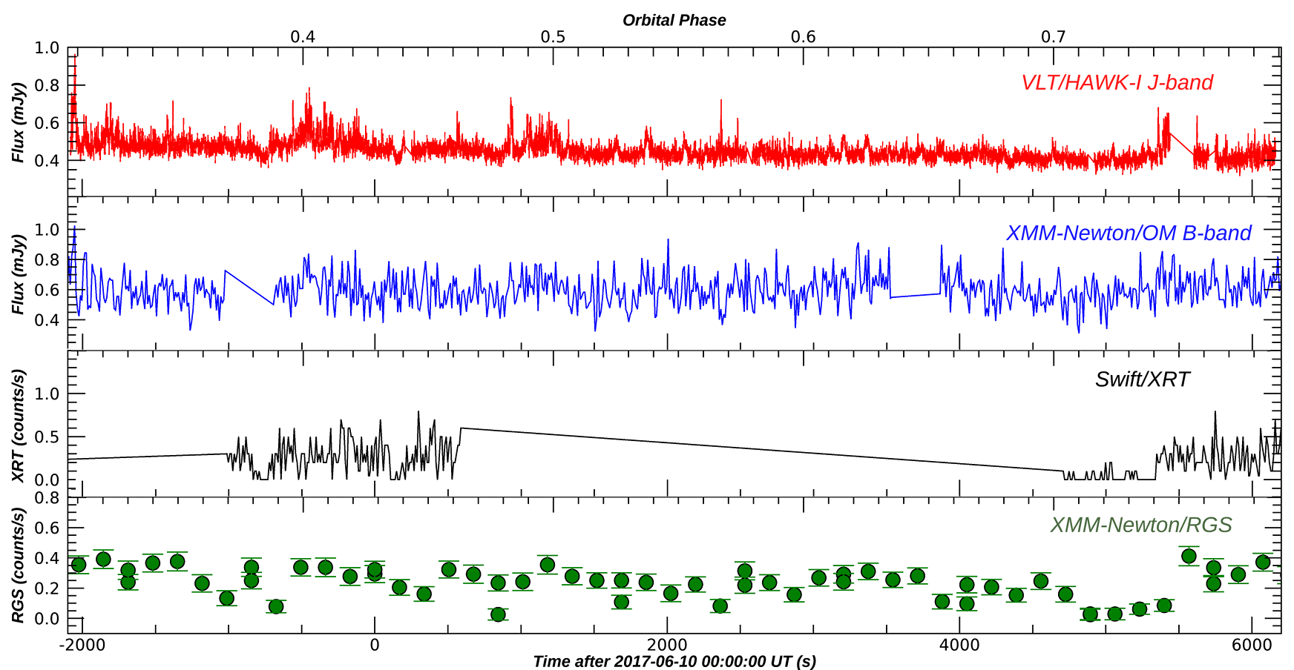
Light curves

Slide 7
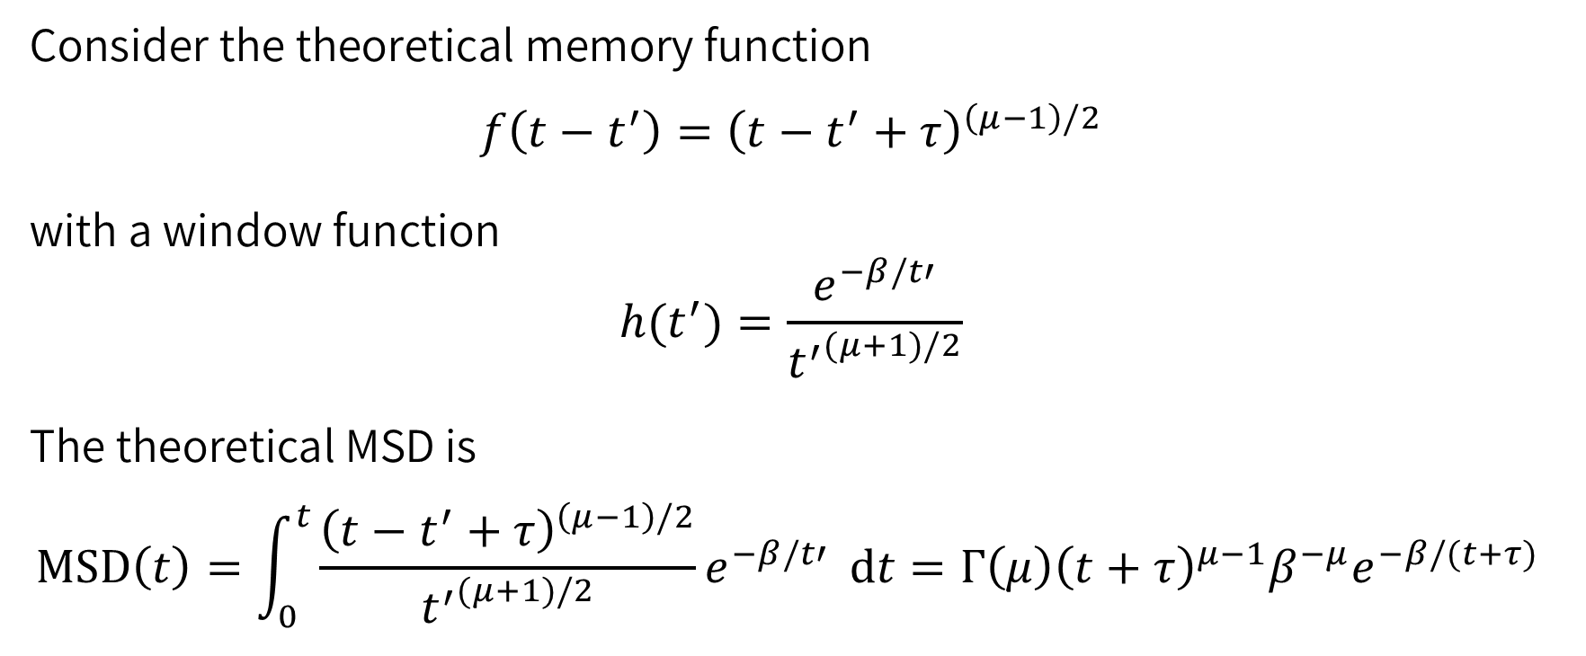
Theoretical MSD
Consider the theoretical memory function
$$f\left(t−t^{′}\right)={\left(t−t^{′}+τ\right)}^{\left(μ−1\right)/2}$$
with a window function
$$h(t^{′})=\frac{e^{−β/t′}}{{t^{′}}^{(μ+1)/2}}$$
The theoretical MSD is
$$MSD\left(t\right)=\int_{0}^{t}{\frac{{\left(t−t^{′}+τ\right)}^{\left(μ−1\right)/2}}{{t^{′}}^{(μ+1)/2}}e^{−β/t′}} dt=Γ\left(μ\right){\left(t+τ\right)}^{μ−1}β^{−μ}e^{−β/(t+τ) }$$

Slide 8
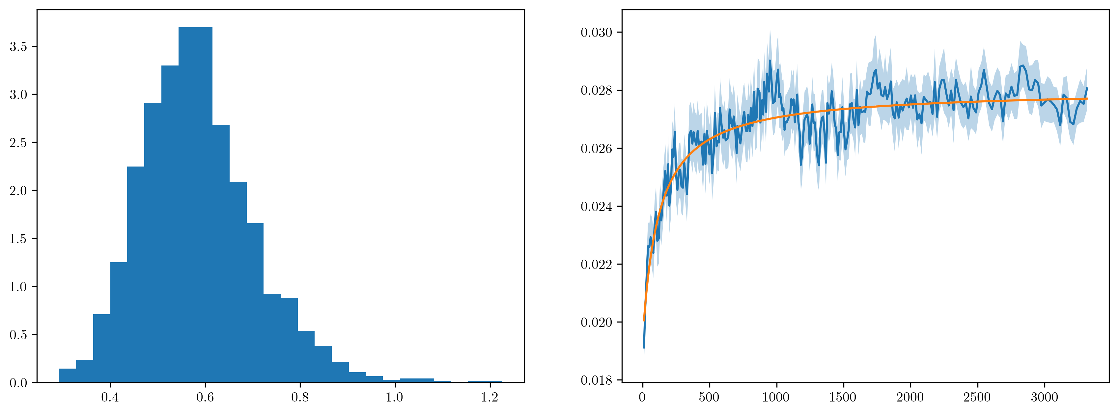

Raw data
The behavior of the raw data is consistent to a process without memory!
($μ=1.001±0.002$)

Slide 9
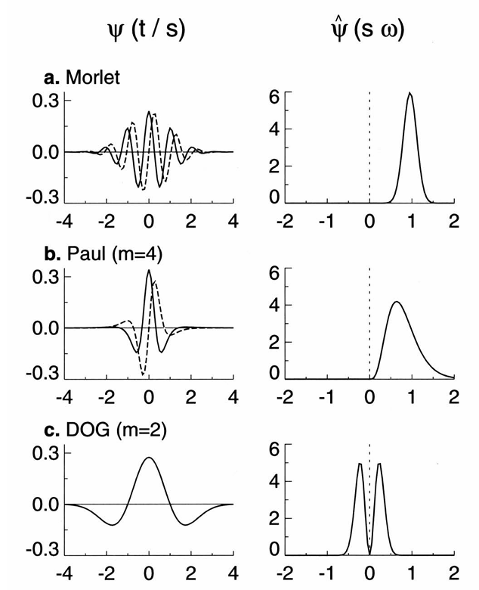
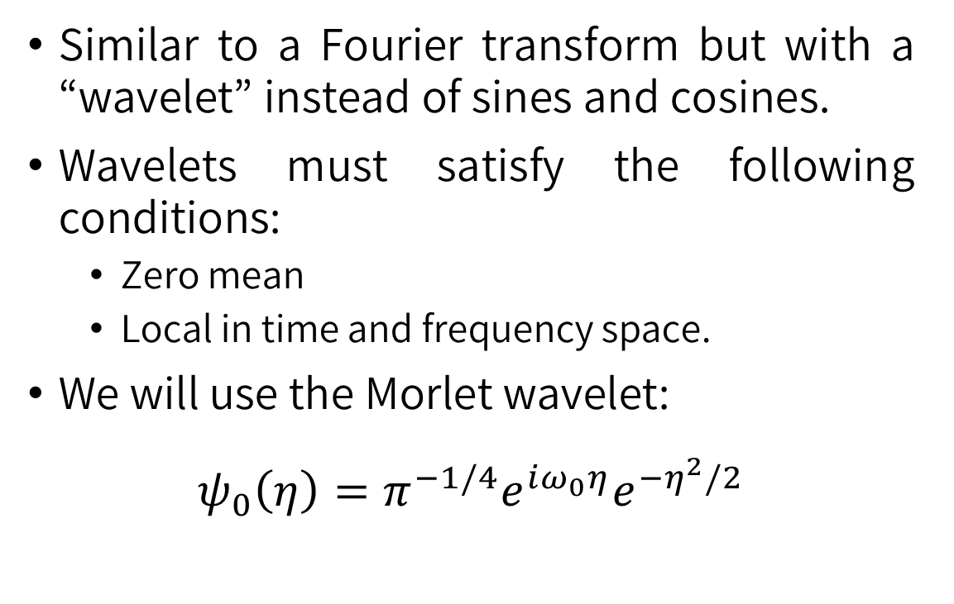
Wavelet Transform
Similar to a Fourier transform but with a “wavelet” instead of sines and cosines.
Wavelets must satisfy the following conditions:
Zero mean
Local in time and frequency space.
We will use the Morlet wavelet:
$$ψ_{0}\left(η\right)=π^{−1/4}e^{iω_{0}η}e^{−η^{2}/2}$$
Torrence, C., & Compo, G. P. (1998). A practical guide to wavelet analysis. Bulletin of the American Meteorological society, 79(1), 61-78.

Slide 10
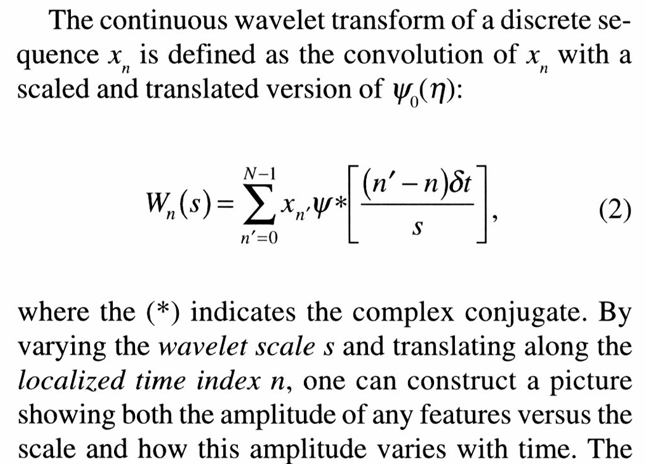
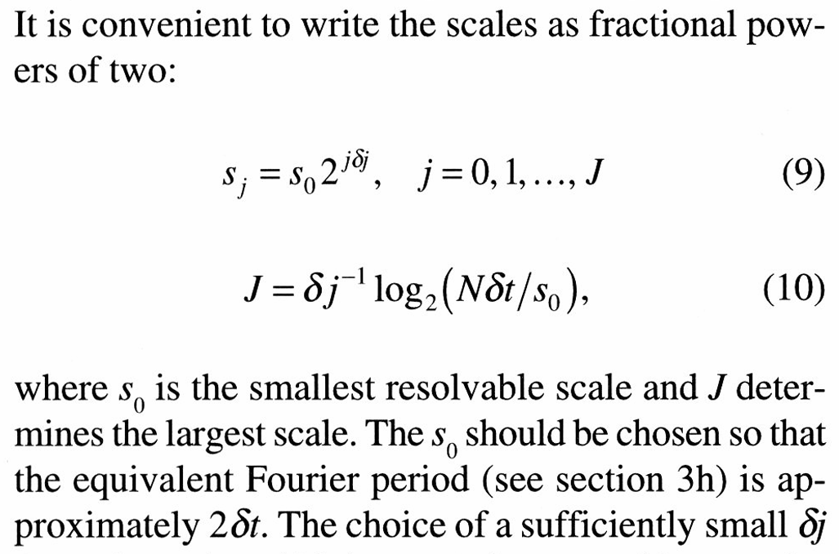
Morlet wavelet
Torrence, C., & Compo, G. P. (1998). A practical guide to wavelet analysis. Bulletin of the American Meteorological society, 79(1), 61-78.

Slide 11
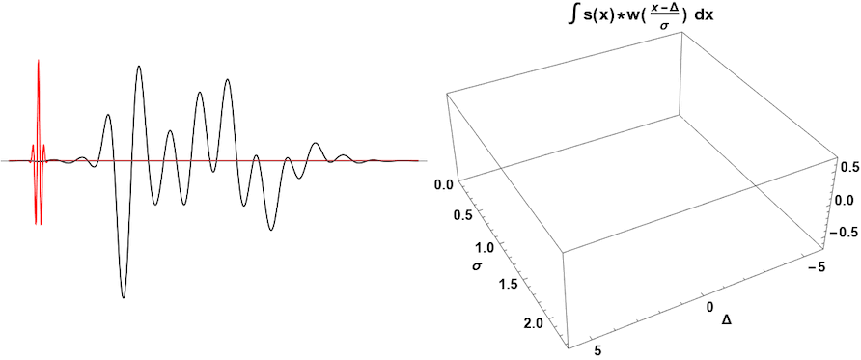
Morlet wavelet
Torrence, C., & Compo, G. P. (1998). A practical guide to wavelet analysis. Bulletin of the American Meteorological society, 79(1), 61-78.

Slide 12
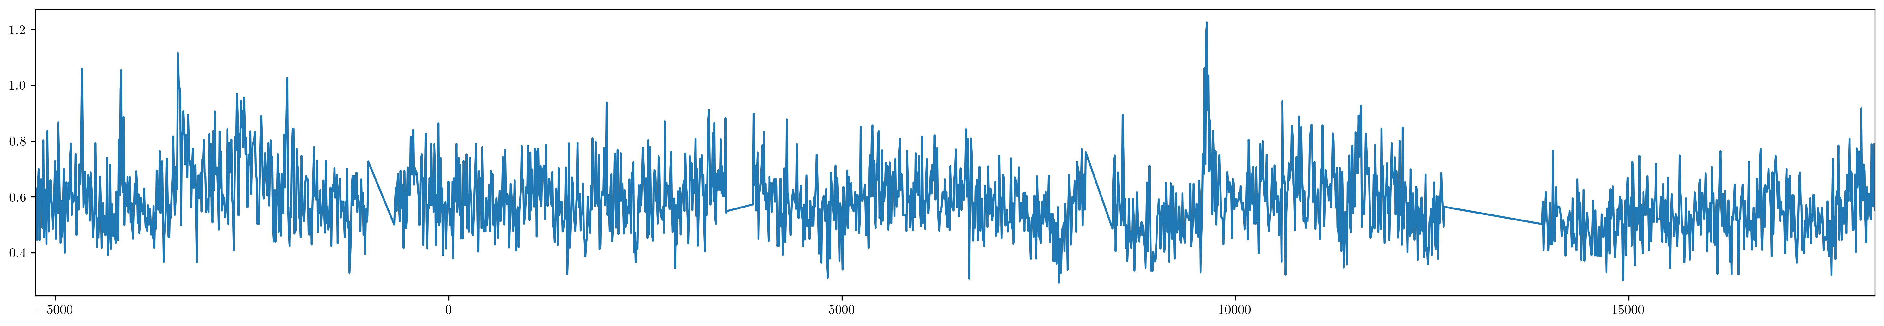
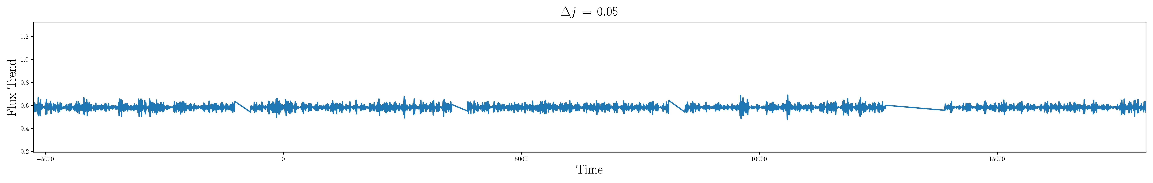
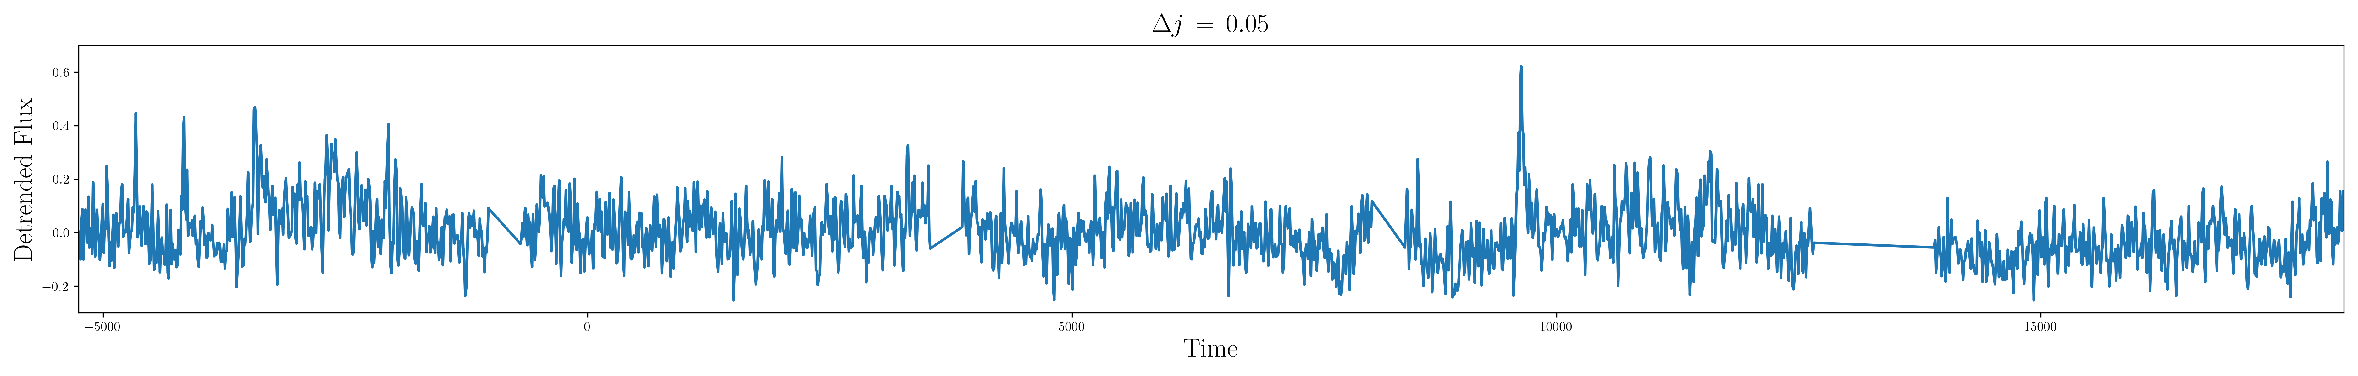
Detrending with the Morlet wavelet

Slide 13
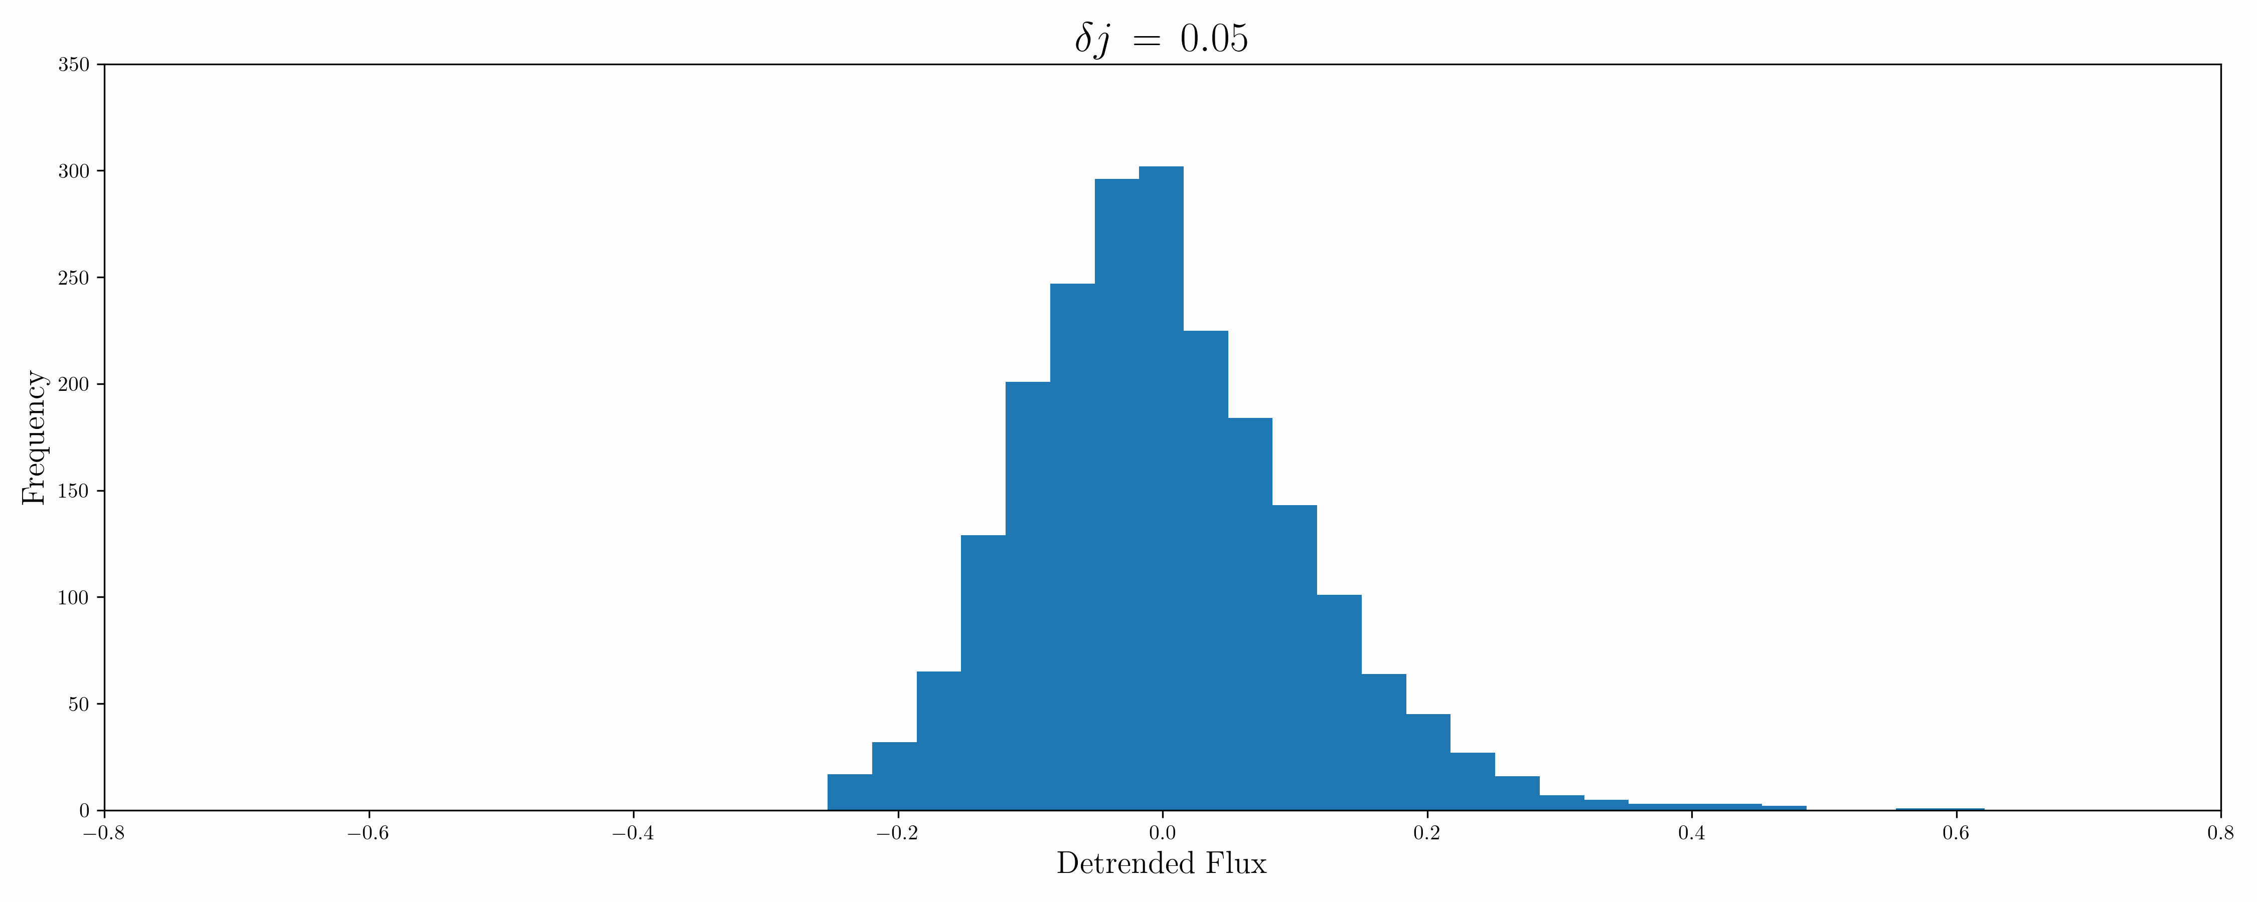
Histogram

Slide 14
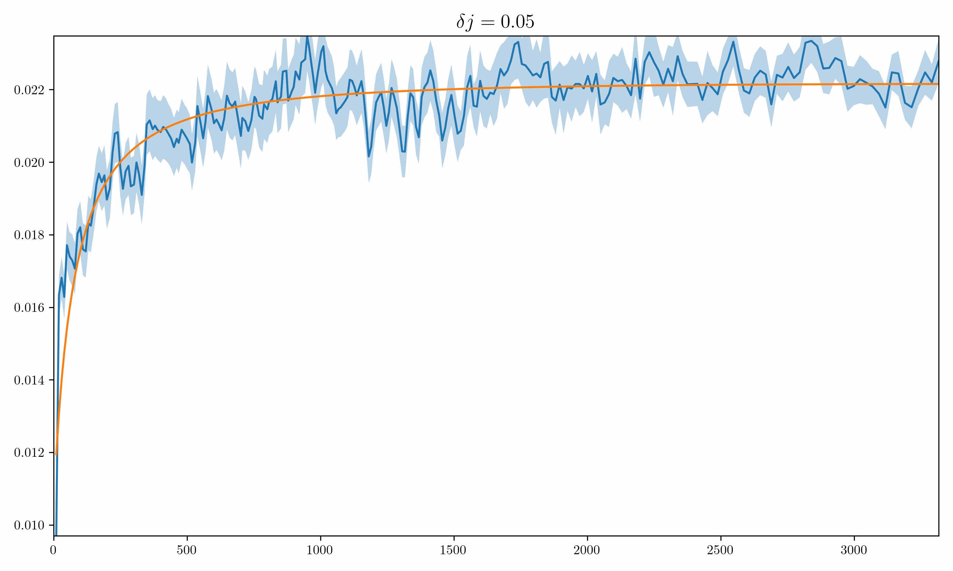
MSD curve fitting

Slide 15
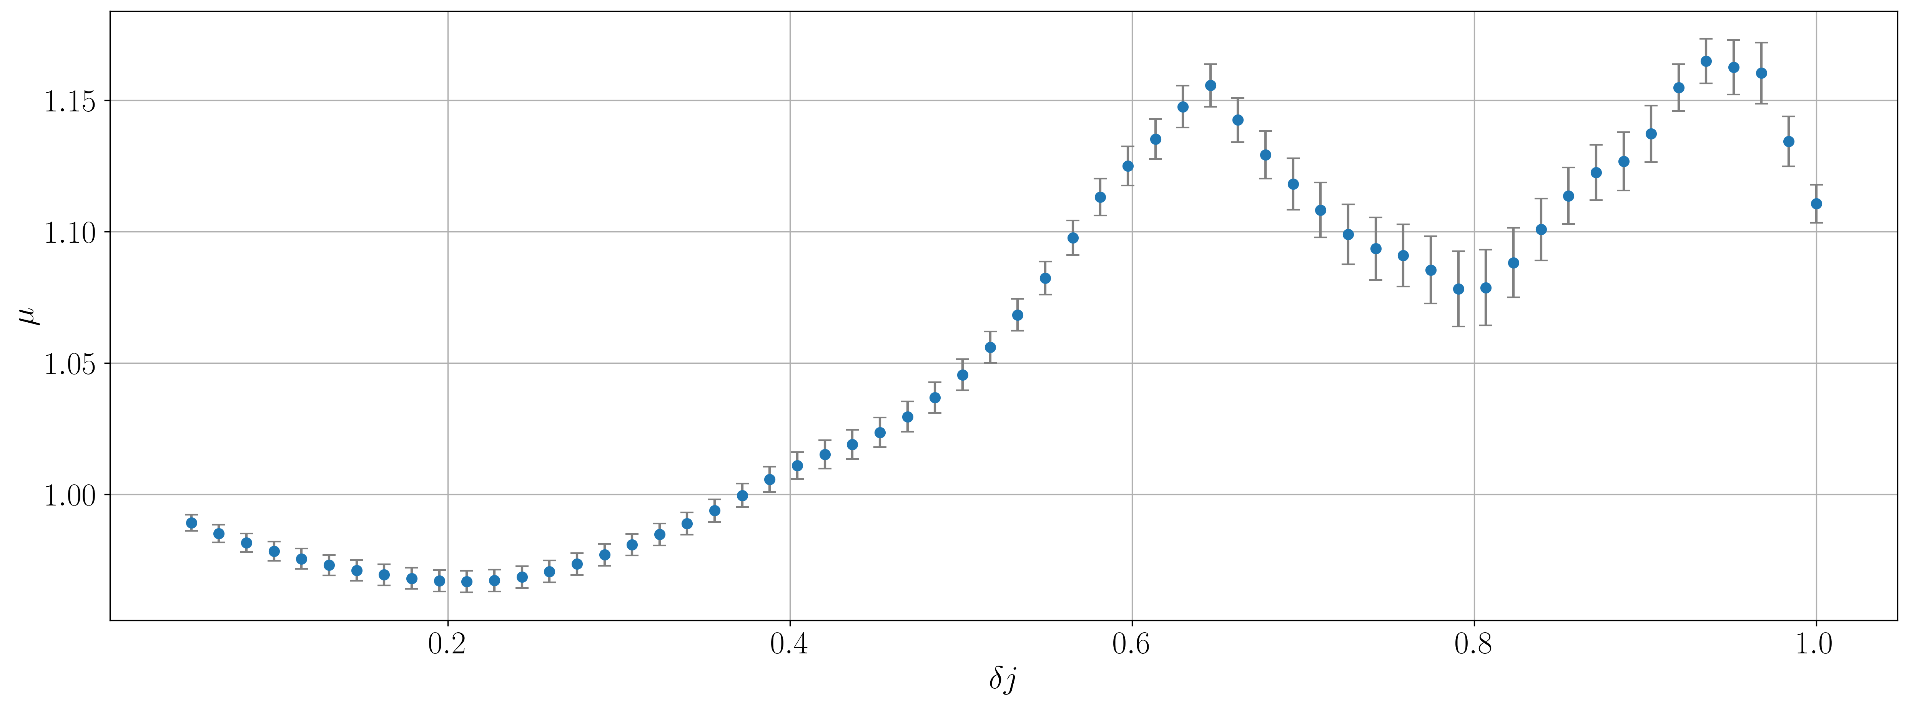

Variations on $μ$
It seems as if the existence of spikes induces a subdiffusive behavior for the system.

Slide 16
Different time scales
Short-term mode switching
frequent transitions between high and low X-ray states, correlated with active and passive optical states.
on the order of seconds to minutes
Flaring
strong flares occur in NIR light curves (possibly correlated with B-band)
on the order of thousands of seconds

Slide 17
End

